Slide 1
Classroom Decorum
ENGR
George V. Krestas
Engineering Department
De Anza College

Slide 2

Rule #1
The class has a well defined starting and ending time.
It’s not like a fast food restaurant where you can come and go as you please!
Entering and leaving the classroom at will disturbs the learning process.
GVK

Slide 3

Rule #2
Take care of your physical needs
Before entering the classroom.
It’s not like a fast food restaurant where you can come and go as you please!
Entering and leaving the classroom at will disturbs the learning process.
GVK

Slide 4

Rule #3
The classroom is not the cafeteria!
Note the sign above the whiteboard.
Your eating disturbs the learning process.
GVK

Slide 5


Rule #4
The classroom is NOT a telephone booth!
If you are expecting an emergency call, do us all a favor, stay home!
The classroom is not an Internet Café!
Text-messaging is a distraction to the others around you who are here to learn.
Both activities disturb the learning process.
GVK

Slide 6
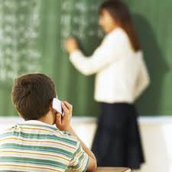
Rule #5
There is a new phone App!
It’s called RESPECT!
Put your phone away & Pay attention to those talking to you?
It’s a RUDE behavior; expect to be treated accordingly!
GVK

Slide 7
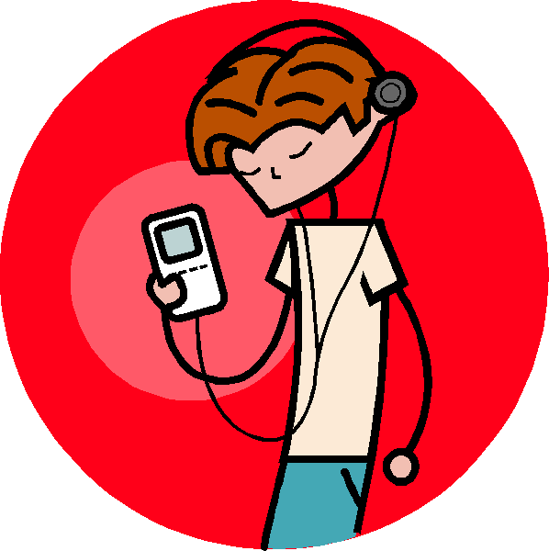
Rule #6
The classroom is NOT a nightclub!
Put your entertainment equipment out of sight and out of mind before entering the classroom.
If you don’t want to hear what I say, stay home.
It’s a RUDE behavior; expect to be treated accordingly!
GVK

Slide 8

Rule #7
Childhood comes with an expiration date.
That date is when you enter College!
Drop the high school attitude, if you want to be successful in college!
Your antics disturbs the learning process.
GVK

Slide 9
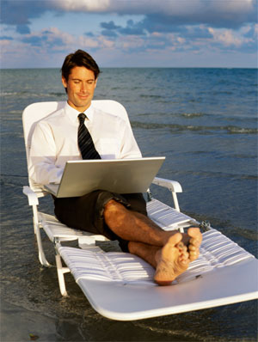
Rule #8
The classroom is not
affiliated with
Club Med!
How you sit tells a lot about you and your attitude!
It disturbs others who are here to learn.
GVK

Slide 10
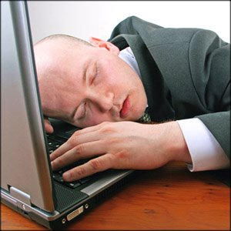
Rule #9
The classroom is not your bedroom!
The State pays for your education, NOT for a place to sleep
Nobody learned anything sleeping!
Besides your snoring distracts the rest of us who are here to learn.
GVK

Slide 11
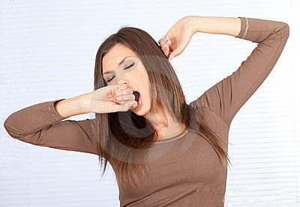

Rule #10
Public pandiculation or loud yawning are rude and disrespectful behaviors.
If you are bored, don’t waste yours and our time, go home.
Be discreet and cover your mouth!
Being a college student means being an alert participant in the learning process.
GVK

Slide 12

Rule #11
The classroom is not the British Parliament!
If you want to talk in class,
Get your own class.
If you want to argue, join the debate society.
Both are RUDE behaviors; expect to be treated accordingly!
GVK

Slide 13
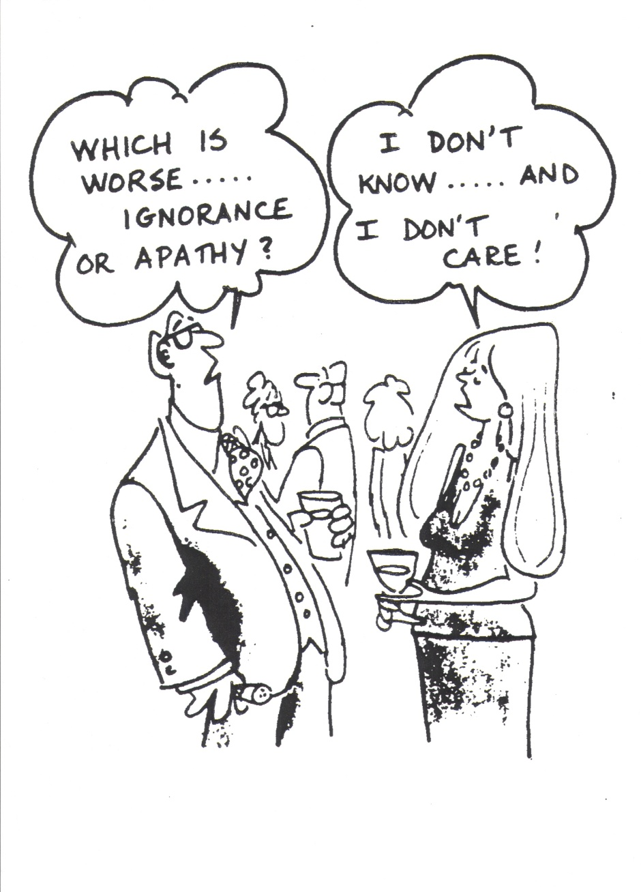
Rule #12
If you have the
“I don’t know and I don’t care” attitude …
You are wasting Yours
and everybody else’s time being in class
Perhaps, you should reevaluate your priorities in life.
13
GVK

Slide 14
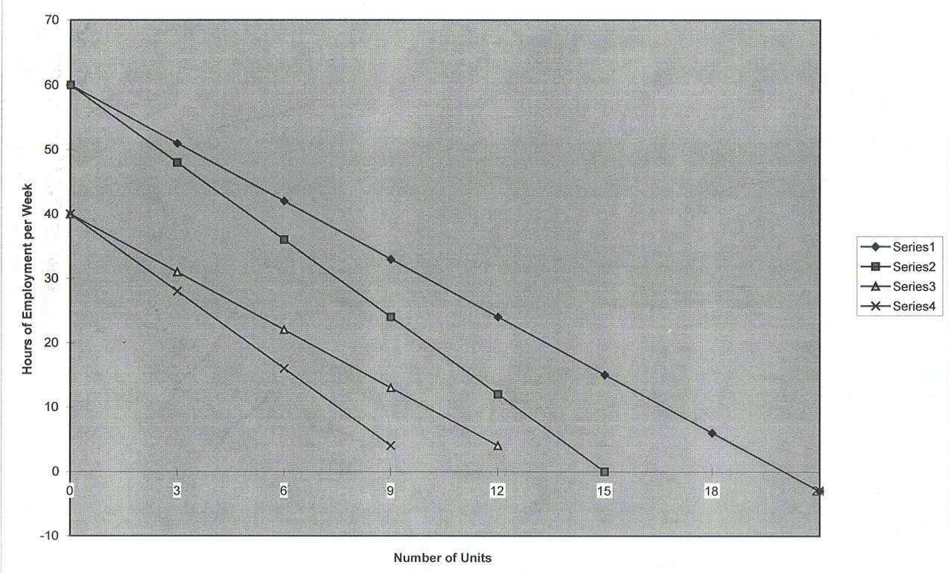
Rule #13
“There are only 24 hours in a day!
Plan accordingly.
Otherwise, school or work or both will suffer!
This chart is the result of a five year study at the School of Engineering at SJSU.
It correlates the optimum number of units one should take vs. the number hours he/she works.
GVK

Slide 15
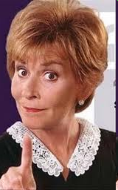
Rule #14
Judge Judy says:
“There is only one attitude here,
and that’s mine”
“They don’t pay me to be here because I am gorgeous,
they pay me because I am smart!”
15
GVK

Slide 16
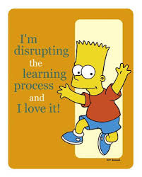
Rule #15
Prof. GVK says:
If you are not here to learn, do me and yourself a favor and take the class from someone else! GVK

Slide 17
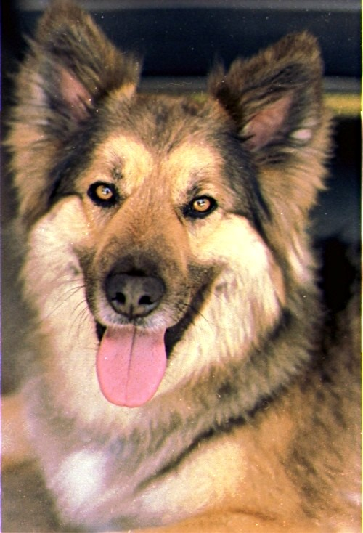
Frixos says:
Some people blame others for their misfortunes, yet their fate is mostly but the echo of their character and efforts, their mistakes and weaknesses. Democritus
The End

Slide 18




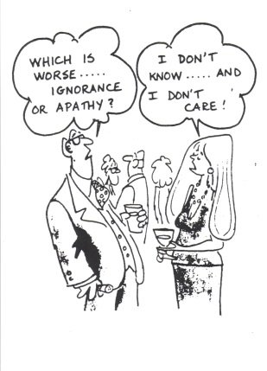



Review
18
GVK

